Slide 1
CHAPTER 1
REIMBURSEMENT, HIPAA, AND COMPLIANCE

Slide 2
Third-Party Reimbursement Issues
Each coding system plays critical role in reimbursement
Your job is to optimize payment
Notes:
What entity is the largest third-party payer in the U.S.? (Medicare)

Slide 3
Your Responsibility
Ensure accurate coding data
Obtain correct reimbursement for services rendered
Upcoding (maximizing) is never appropriate
Notes:
What is the coder’s role? (To accurately code the services and procedures rendered so that the office is properly reimbursed)
Ethical issues will continually surface and must be handled by coders. What are some examples? (Pressure to upcode a procedure, to restate a diagnosis to obtain better payment)
Upcoding, assigning comorbidity/complications based only on laboratory values, and using nonphysician impressions or assessments without physician agreement are fraudulent.

Slide 4
Population Changing
Elderly fastest growing patient segment
The population over age 60 projected to reach 77.6 million by 2020.*
Medicare primarily for elderly
* Administration for Community Living (ACL): Justification of Estimates for Appropriations Committees, Fiscal Year 2018, https://www.acl.gov/sites/default/files/about-acl/2017-05/FY%202018%20ACL%20Budget%20Congressional%20Justification%20v2.pdf
Notes:
What issues do population changes create for the health care industry? (As people live longer, and as the baby boomers reach retirement, the elderly population will increase, creating greater use of health care services, and Medicare becomes an even greater component of a medical office’s revenues.)

Slide 5
Medicare—Getting Bigger All the Time!
Health care will continue to expand to meet enormous future demands
Job security for coders!
Notes:
Increasing numbers of elderly people, technological advances, and improved access to health care have increased consumer use of health care services.

Slide 6
Basic Structure Medicare
Medicare program established in 1965
2 parts: A and B
Part A: Hospital insurance
Part B: Supplemental—non-hospital
Example: Physicians’ services and medical equipment
Part C: Medicare Advantage, health care options (Added later and formerly termed Medicare + Choice)
Part D: Prescription drugs
Notes:
The Medicare program was established in 1965 with the passage of the Social Security Act.
The program dramatically increased the government’s involvement in health care. What are the advantages and disadvantages of this? (Advantage: More elderly and disabled people have access to affordable health care. Disadvantage: Government involvement brings bureaucracy and complicated regulations.)

Slide 7
Those Covered
Originally established for those 65 and over
Later disabled and permanent renal disease (end-stage or transplant) added
Persons covered “beneficiaries”
Notes:
Individuals covered under Medicare are called “beneficiaries.”

Slide 8
Officiating Office
Department of Health and Human Services (DHHS)
Delegated to Centers for Medicare and Medicaid Services (CMS)
CMS runs Medicare and Medicaid
CMS delegates daily operation to Medicare Administrative Contractors (MACs)
MACs usually insurance companies
Notes:
CMS was formerly HCFA, the Health Care Financing Administration.
What are the responsibilities of the CMS? (CMS operates Medicare, using Medicare Administrative Contractors, private insurance companies that handle Medicare in specific areas.)

Slide 9
Funding for Medicare
Social Security taxes
Equal match from government
CMS sends money to MACs
MACs handle paperwork and pay claims
Notes:
The funds to run Medicare are generated from payroll taxes paid by employers and employees.
Who collects and handles Medicare funds? (Social Security Administration collects and handles the funds, which flow through CMS to the MACs.)

Slide 10
Medicare Covers (Part B)
Beneficiary pays
20% of cost of service
+ annual deductible
Medicare pays
80% of covered services
Notes:
Medicare pays 80% of covered charges, and the beneficiary pays the remaining 20% (the coinsurance payment).
What else does the beneficiary pay? (Deductibles, premiums, and noncovered services).
Beneficiaries often choose to purchase additional insurance to cover out-of-pocket expenses.

Slide 11
QIO Program
National network of consumers, physicians, hospitals, and other caregivers
Work to improve quality, timing, and cost of care for Medicare patients

Slide 12
Two types of QIOs
Beneficiary and Family Centered Care (BFCC)
Assists beneficiaries directly
Quality of care reviews
Filing complaints or appeals
Quality Innovation Network (QIN)
Organizes beneficiaries, providers, and community members for improvement initiatives
Data driven approach
Focus on safety, health quality, and care coordination

Slide 13
Part A, Hospital
More than 99% of hospital claims submitted electronically
Hospitals submit paper charges on CMS-1450 (UB-04)/837i
Diagnosis codes basis for payment
MS-DRG (Medicare Severity Diagnosis Related Groups)
More on this topic in Chapter 27
(Cont’d…)
Notes:
Hospitals report services for Part A by using ICD-10-CM codes and the DRG assignment.
What determines eligibility for Part A? (Beneficiaries are automatically eligible for Part A when they become eligible for Medicare.)

Slide 14
Part A, Covered In-Hospital Expenses
(…Cont’d)
Semiprivate room
Meals and special diets in hospital
All medically necessary services
(Cont’d…)
Notes:
This is a listing of services that are covered by Medicare Part A.
Medicare Part A would cover the basics of a hospital stay.
A way to look at it would be a “No Frills” stay.

Slide 15
Part A, Noncovered In-Hospital Expenses
(…Cont’d)
Personal convenience items
Example:
Slippers, TV
Non-medically necessary items
(Cont’d…)
Notes:
This is a listing of services that are not covered by Medicare Part A.
Anything that Medicare would deem not medically necessary would not be covered under Medicare Part A for a hospital stay.

Slide 16
Part A, Other Covered Expenses
(…Cont’d)
Rehabilitation
Skilled nursing
Some personal convenience items for long-term illness or disabilities
Home health visits
Hospice care
Not automatically covered
Must meet certain criteria
Notes:
Part A can also help pay for inpatient care in a Medicare-certified skilled nursing facility if the patient’s condition requires daily skilled nursing or rehabilitation services that can be provided only in this type of facility.

Slide 17
Part B, Supplemental
Part B pays services and supplies not covered under Part A
Not automatic
Beneficiaries purchase
Pay monthly premiums
(Cont’d…)
Notes:
Part B is not automatically provided to beneficiaries when they become eligible for Medicare.
Medicare Part B, like Blue Cross of North Dakota for example, is an insurance the individual purchases and pays monthly premiums.
Currently, Medicare Part B reimburses at a rate of 80%, which means that if the patient does not have a secondary insurance the patient will be responsible for the other 20%.

Slide 18
Type of Items Covered by Part B
(…Cont’d)
Physicians’ services
Outpatient hospital services
Home health care
Medically necessary supplies and equipment
Notes:
Part B helps to pay for medically necessary physician services, outpatient hospital services, home health care, and a number of other medical services and supplies that are not covered by Part A.

Slide 19
Coding for Medicare Part B Services
Three coding systems used to report Part B
CPT
HCPCS
ICD-10-CM
Notes:
What is each type of code used for? (Diagnoses, procedure, additional supplies and services, respectively)
What is Part C? (Medicare Plus Choice program: provides a set of options from which beneficiaries can choose their health care providers; some options are HMO, POS, PPO, and MSA [medical savings account])
What is Part D? (Prescription drug benefit for beneficiaries. Beginning in January 2006, beneficiaries could enroll in Part D and choose from plans that offered drug coverage.)

Slide 20
Health Insurance Portability and Accountability Act
Established 1996
Administrative simplification
Largest change
Includes:
Electronic transactions
Privacy
Security
National Identifier Requirements (NPI)

Slide 21
Federal Register
Government publishes changes in laws
Coding supervisors keep current on changes
(Cont’d…)
Notes:
What is the Federal Register? (The official publication for all Presidential Documents, Rules and Regulations, Proposed Rules, and Notices.)
Coders must be aware of changes listed in the Federal Register that relate to Medicare reimbursement so that Medicare charges will be submitted correctly.
Because the government is the largest third-party payer in the nation, even small changes in rules governing reimbursement to providers can have major consequences.

Slide 22
Issues of Importance in Federal Register
(…Cont’d)
October contains hospital facility changes
November and December contain major outpatient facility changes and physician fee schedule
Notes:
Each year proposed changes to the various payment systems are published early.
Several months pass so that interested parties can comment and make suggestions about the proposed changes.
The final rules are published in the fall editions.
Changes are implemented the following calendar year.

Slide 23
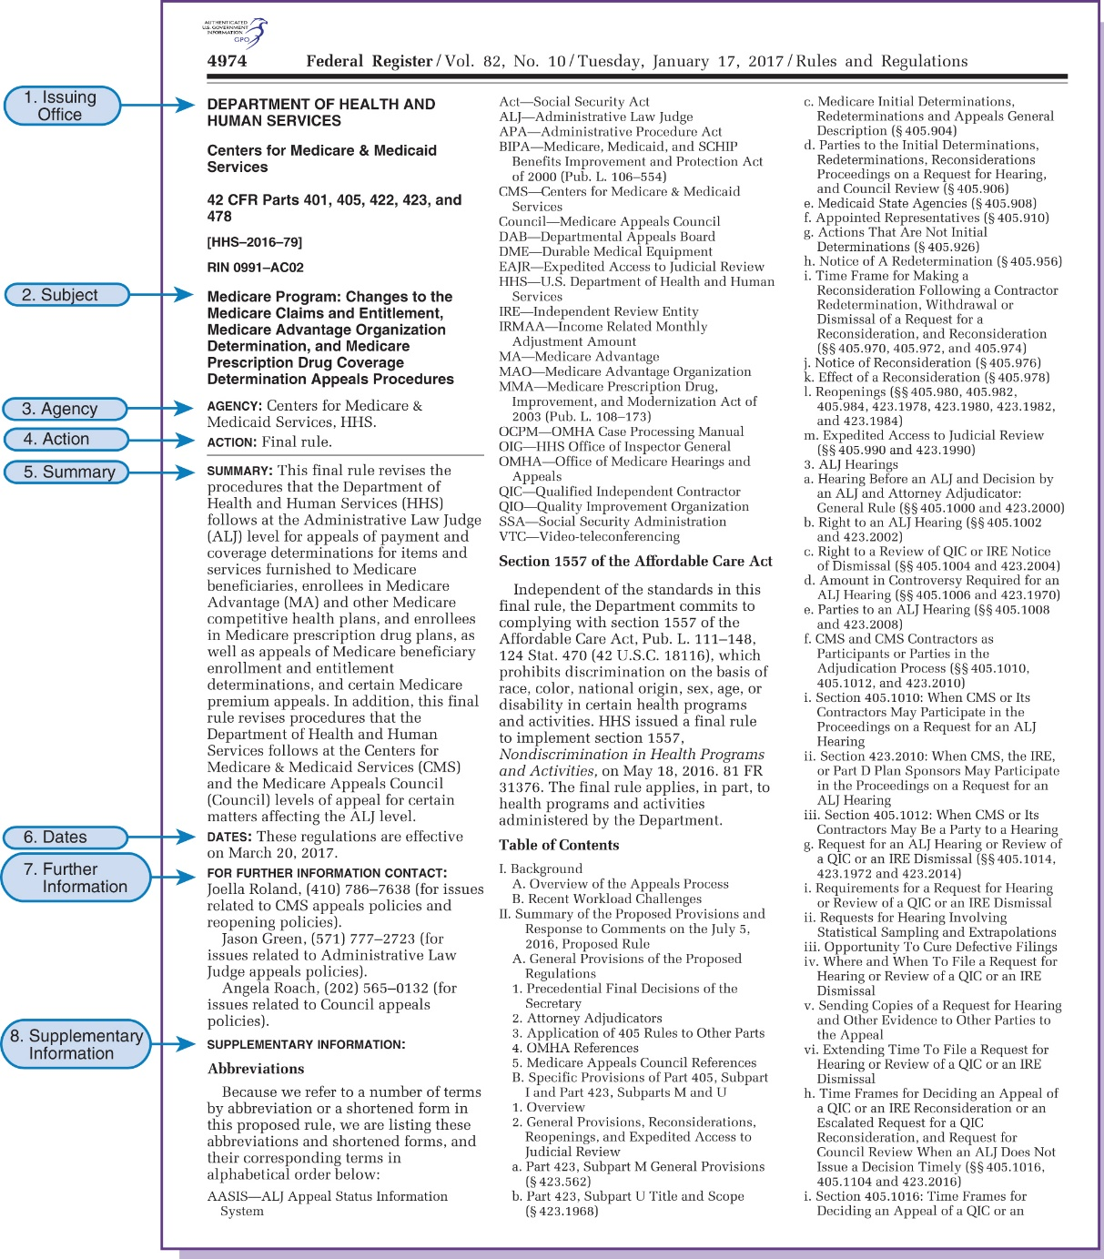
Federal Register
Figure 1.3
From Federal Register, January 17, 2017, Vol. 82, No. 10, Rules and Regulations.
Notes:
Here is a sample page from the Federal Register.

Slide 24
Outpatient Resource–Based Relative Value Scale
RBRVS
Physician payment reform implemented in 1992
Paid physicians lowest of
1. Physician’s charge for service
2. Physician’s customary charge
3. Prevailing charge in locality
Notes:
Why was physician payment reform implemented? (To decrease Medicare expenditures, to redistribute physicians’ payments more equitably, to ensure quality health care at a reasonable rate)
OBRA 1990 required that before January 1 of each year, beginning in 1992, fee schedules that determine payment amounts for all physician services would be established.

Slide 25
National Fee Schedule
Replaced RBRVS
Termed Medicare Fee Schedule (MFS)
Payment 80% of MFS, after patient deductible
Used for physicians and suppliers
Notes:
All physicians are paid on the amounts of the Medicare fee schedule.

Slide 26
Relative Value Unit
Nationally, unit values assigned to each CPT code
Local adjustments made:
Work and skill required
Overhead costs
Malpractice costs
(Cont’d…)
Notes:
How are unit values determined? (The amount of time, effort, and technical expertise required, overhead, cost of malpractice coverage)
A Harvard University group analyzed a service, identified its separate parts, and assigned each part a relative value unit.
These parts, or components of service, are work (time, effort, and skill), overhead, and malpractice.
The sum of the units established for each component of the service equals the total RVUs of a service.

Slide 27
Relative Value Unit (RVU)
(…Cont’d)
Often referred to as fee schedule
Annually, CMS updates RVU based on national and local factors
Beneficiary Protection
Physician Payment Reform
Omnibus Budget Reconciliation Act of 1989
Maximum Actual Allowable Charge (MAAC) 1991
Notes:
What are the Geographic Practice Cost Index and the Conversion Factor? (National dollar amount that is applied to all services paid according to the Medicare Fee Schedule and geographic location.)

Slide 28
Geographic Practice Cost Index (GPCI) and Conversion Factor (CF)
GPCI: Geographic Practice Cost Index
Scale of cost variance of charge locations
Charge location may be entire state
CF: Conversion Factor
National dollar amount
Paid on Medicare Fee Schedule basis
Converts RVUs to dollars
Updated yearly

Slide 29
Medicare Fraud and Abuse
Program established by Medicare
To decrease fraud and abuse
Fraud
Intentional deception to benefit
Example:
Submitting for services not provided
Notes:
Medicare defines fraud as “the intentional deception or misrepresentation that an individual knows to be false and does not believe to be true and makes it knowing that the deception could result in some unauthorized benefit to himself/herself or to some other person.”
What are some examples of fraud? (Altering medical records, upcoding, phantom billing, double-billing for same service, etc.)

Slide 30
Beneficiary Signatures
Beneficiary signatures on file
Service, charges submitted without need for patient signature
Presents opportunity for fraud
(Cont’d…)
Notes:
Most Medicare patients sign a standing approval, which is kept on file in the medical office.
This allows Medicare claims to be filed automatically, which makes it easy for an unscrupulous person to submit charges for services that were never provided.

Slide 31
Fraud
(…Cont’d)
Anyone who submits for Medicare services can be violator
Physicians
Hospitals
Laboratories
Billing services
YOU
Notes:
Coders must validate that the service was actually provided by consulting the medical record or the physician.

Slide 32
Fraud Can Be
Billing for services not provided
Misrepresenting diagnosis
Kickbacks
Unbundling services
Falsifying medical necessity
Routine waiver of copayment
Notes:
Discuss how medical professionals, especially coders, should react if they suspect fraud.

Slide 33
Office of the Inspector General (OIG)
Each year develops Work Plan
Outlines monitoring Medicare program
MACs monitor those areas identified in plan
Notes:
Office of the Inspector General (OIG) is responsible for developing a work plan that outlines the ways in which the Medicare program is monitored to identify fraud.

Slide 34
Complaints of Fraud
Submitted orally or in writing to MACs or OIG
Allegations made by anyone against anyone
Allegations followed up by MACs and/or OIG
Notes:
Describe several circumstances in which coders may have to react to suspicious activities (by physician, patient, fellow coder, etc.).

Slide 35
Abuse
Generally involves
Impropriety
Lack of medical necessity for services reported
Review takes place after claim submitted
May go back and do historic review of claims
Notes:
Abuse reviews involve checking the propriety or medical necessity of services that are billed; these reviews generally occur after claims processing activity.
Fraud reviews may determine, for example, whether or not billed services were furnished.

Slide 36
Kickbacks
Bribe or rebate for referring patient for any service covered by Medicare
Any personal gain = kickback
A felony
Fine or
Jail or
Both
Notes:
What is a “safe harbor” clause? (Protects against certain types of medical services being discounted)
What are examples of what is or is not protected under the “safe harbor” clause? (Protected: An HMO contracts with a laboratory for all laboratory services and receives a discounted price; not protected: furnishing an item or service free of charge or at a reduced charge in exchange for any agreement to buy a different item or service.)

Slide 37
Protect Yourself
Use your common sense
Submit only truthful and accurate claims
If you are unsure about charges
Check with physician or supervisor
Notes:
Coders are one group that CMS holds responsible for submitting truthful and accurate claims.

Slide 38
Managed Health Care
Network health care providers that offer health care services under one organization
Group hospitals, physicians, or other providers
Notes:
What is the purpose of managed health care? (To provide cost-effective services and improve the health care services provided to enrollees by ensuring access to care)

Slide 39
Managed Care Organizations
Responsible for health care services to an enrolled group or person
Coordinates various health care services
Negotiates with providers
Notes:
The organization coordinates the total health care services required by its enrollees.

Slide 40
Preferred Provider Organization (PPO)
Providers form network to offer health care services as group
Enrollees who seek health care outside PPO pay more
Notes:
PPO providers agree to provide services to enrollees at a discounted rate.
Enrollees pay a portion of the costs when using a PPO provider.
Out-of-pocket costs are greater when health care is obtained outside of the network.
Patients have In Plan benefits and Out of Plan benefits.

Slide 41
Health Maintenance Organization (HMO)
Total package health care
Out-of-pocket expenses minimal
Assigned physician acts as gatekeeper to refer patient outside organization
Notes:
A Health Maintenance Organization (HMO) is a health care delivery system that allows the enrollee access to all health care services.
Each enrollee is assigned a primary care gatekeeper who has the authority to allow the enrollee to access the services available or to authorize services outside of the HMO.
HMO can employ the physician in a staff model HMO or can contract with the physician through the individual practice association (IPA) model in which the physician provides services for a set fee.

Slide 42
Drawbacks of Managed Care
Organization has incentive to keep patient within organization
Services provided outside organization limited
Patient must have approval to go outside organization if services to be covered
Notes:
Managed care requires patients to stay within the organization, and if the patient chooses to go outside of the network a prior approval or authorization is needed.

Slide 43
Conclusion CHAPTER 1
REIMBURSEMENT, HIPAA, AND COMPLIANCE

