Slide 1
November
NYSACTE FELLOWSHIP
#2

Slide 2
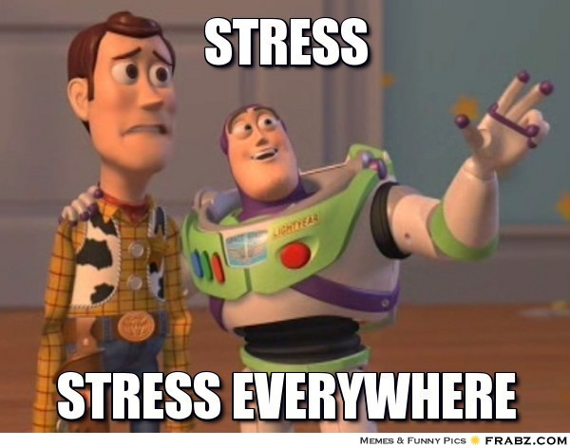
Welcoming Ritual
Check-in – write the number that corresponds with your current status in the chat and tell us why you feel that way.
1
2
3
4

Slide 3
President Presentation
Joanne Ryan
Past President of NYSACTE
Leadership Journey

Slide 4
ACTE
ACTE is a national association representing thousands of career and technical education professionals, all working to make a real difference in students' lives.
MISSION
Provide educational leadership in developing a competitive workforce.
Vision Statement
Empowering educators to deliver high quality CTE programs that ensure all students are positioned for career success.

Slide 5
ACTE Governance Structure

Slide 6
ACTE Divisions
11 Divisions
Administration
Agricultural Education
Business education
*Counseling and Career Development
Engineering and Technology Education
Family and Consumer science Education
Health Sciences Education
*New and Related Services
*Postsecondary, Adult and Career Education
Trade and Industrial Education
The divisions represent the content area focus and/or special interest group of the member.
The divisions provide a specific identity to career and technical educators beyond their state or region; members are also identified by the type of career and technical education they provide or represent.

Slide 7
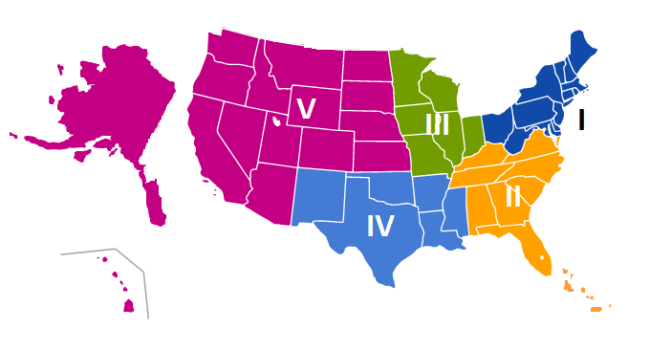
ACTE Regions
Each of the 5 regions represent and organize their State Associations

Slide 8
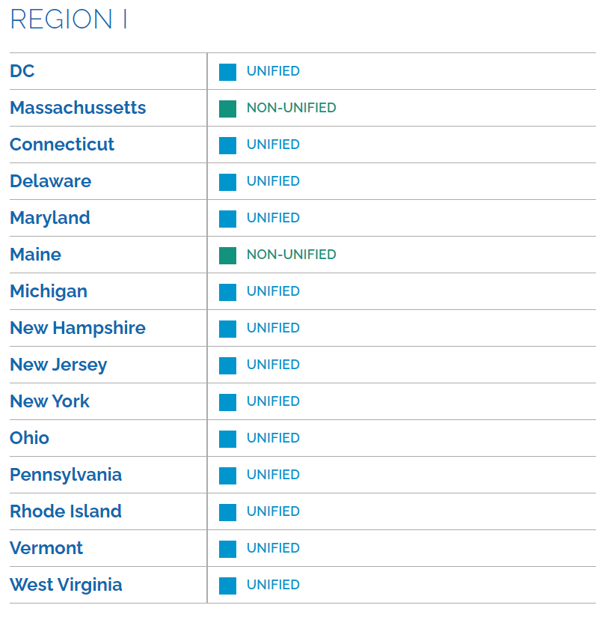
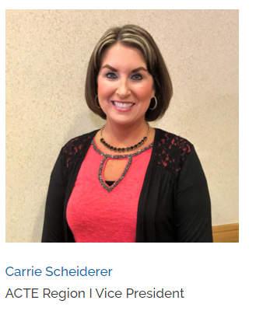
ACTE Region I

Slide 9
ACTE at the State Level
Unified States
State Associations
A legally incorporated entity dedicated to supporting a states’ full community of career and technical educators in partnership with ACTE
Members in unified states belong to both the state and national ACTE organizations
Unified states are not charged for specific services provided by the national ACTE office
The State Associations are separately incorporated and have their own structure
Typically State Associations have their own divisions, which may or may not completely align with National ACTE's division structure.

Slide 10
NYSACTE
NYSACTE, is a statewide organization representing and supporting thousands of career and technical education professionals.
NYSACTE Mission:
To provide leadership in developing a competitive workforce
To provide leadership and unification for Career and Technical Education professional associations
To provide the members of the Career and Technical Education community with professional development
To promote Career and Technical Education with students, student leadership organizations, the education community, and the public
To monitor and initiate legislative and policy activities that enhance and promote Career and Technical Education
President - Rebecca Skretkowicz Past President - Joanne Ryan
Website: http://www.nysacte.org/

Slide 11
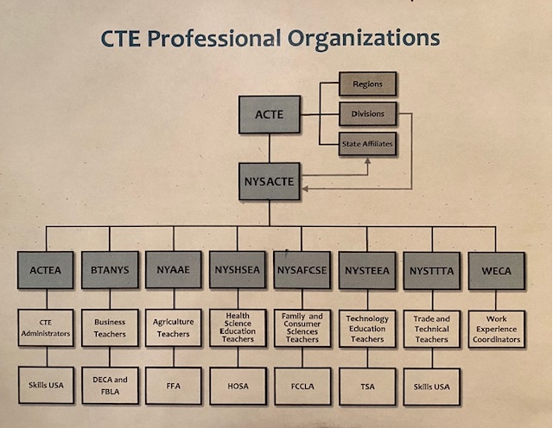
NYSACTE Affiliate Organizations
NYSACTE represents eight different divisions of Career and Technical Education (CTE) in New York State.
These divisions are comprised of Administrators of Career and Technical Education, Agricultural, Business, Family and Consumer Science, Health Occupations, Technology Education, Trade and Tech, and Work-Experience Coordinators

Slide 12
Discussion Norms
Things to keep in mind as we share and discuss:
-Stay confidential (the space is safe, do not share what you hear with others)
-Listen actively and stay mentally engaged
-Be encouraged to participate (you get out of this what you put into it)
-Allow yourself to be vulnerable (share at the level you feel comfortable)
-Agree to disagree (do not be afraid to respectfully challenge one another by asking questions, but refrain from personal attacks and focus on ideas, not people)
-Use “I” Statements (own your experiences)
-Be conscious of body language and non-verbal responses (be mindful of this for yourself and others)

Slide 13
Book Study – Dare to Lead
Breakout Room Discussion
Purpose: to allow participants to reflect, process
and share more deeply within a smaller group
Each group member will take a turn speaking:
-Introduce yourself to the group
-Share your reflections on your Daring Leadership Assessment results and the 10 behaviors described in the Introduction
-What are some of your strengths?
-What do you need to work on?
Group members are encouraged to “listen with the same passion with which we want to be heard”(page 10) and allow the speaker to finish before making connections or asking questions

Slide 14
Book Study – Dare to Lead
Full Group Share - ABC
Each person unmutes and shares an A, B or C based on the assessment, video, introduction or small group discussion
A: an action they will take
B: what they liked best
C: a connection they made

Slide 15
NYSACTE Projects Ideas
--Monthly e-blasts to NYSACTE membership
Advocacy 1- Work with Lisa Mongello our advocacy board member and select fellows from last year to create/lead an advocacy committee.
-Advocacy 2 – Create a survey for division presidents asking them what they need or would expect from the advocacy committee.
-Three times during the school year, write a summary of what is new and happening in their division for a newsletter, e-blast, or the NYSACTE web page..
-CTE Learn 1 - working with ACTE to promote the CTE learn platform for NYSACTE.
-CTE Learn 2 – assist with updating and managing the 21-22 NYSACTE Fellowship Group on CTE Learn
-NYSACTE Website – assist with updating the Fellowship section of the NYSACTE website
-Conduct a project designed to increase membership in NYSACTE, its divisions and ACTE: eblast, mailings, social media outreach.
-Conduct a project to promote CTE during CTE month. Something that can be used by NYSACTE members.
-Social media – Continue Social media projects that were completed by fellows last year (Instagram, Facebook, Twitter, you could just pick one to work on)
-Awards for NYSACTE.

Slide 16
NYSACTE Project Form

Slide 17
NYSACTE Project Questions or Concerns

Slide 18
CTE Learn
If you do not already have a free CTE Learn account, please create one
Click the link to get to our 21-22 NYSACTE Fellows group on CTE Learn
https://www.careeredlounge.com/pg/groups/7801602/
You may be prompted to log in to CTE Learn first
Click the Request Membership box
Once your membership is approved, you will be able to go to this site to access the updated fellowship documents, templates, ppts, links, etc.

Slide 19
Reminders and Upcoming Deadlines
NYSACTE Project form (questions 1 and 2) due November 30
Interview your division president
December 17th

Slide 20
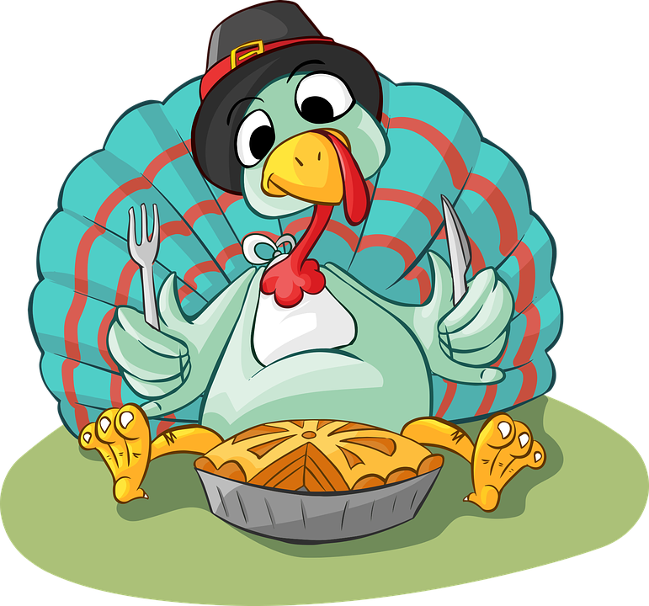
Optimistic Closure
What are you looking forward to most during your time off for Thanksgiving?
a holiday food/tradition that is important to your family. The type of food/tradition that makes you say “It just wouldn’t be (fill in a holiday) without ____________________.”
a holiday food/tradition that you
dread and will not eat or participate in

