Slide 1
Introduction to Global Business
Chapter 1 The Rise of Globalization

Slide 2
After studying this chapter, you should be able to:
Explain the characteristics of globalization and describe how it functions.
Identify how major international institutions facilitate globalization.
Evaluate the need for strong and transparent institutions that can adapt to global competition.
Describe the key policy measures that make globalization sustainable.

Slide 3
After studying this chapter, you should be able to:
Describe the role of information technology in bridging the global digital divide.
Describe the validity of the anti-globalization argument.
Explain the case made to temporarily support those people negatively affected by globalization.

Slide 4
What Is Globalization?
Globalization is the socioeconomic reform process of eliminating trade, investment, cultural, information technology, and political barriers across countries.
It can lead to increased economic growth and geopolitical integration and interdependence among nations of the world.
It is no longer simply another word for “Westernization” or “Americanization.”

Slide 5
Emerging Economies
Emerging economies
Are implementing more open trade and free-market policies to “compete with everyone from everywhere for everything”
Are becoming the world’s center of economic gravity through innovation, research, and development
BRIC economies
Brazil, Russia, India, and China

Slide 6
Decoupling and the Move to a Multipolar World Economic Order
Decoupling
A global shift in which industrialized country-dependent developing economies grow based on their own underlying economic strengths rather than those of highly-developed countries
Multipolar world
A world economy in which the engines of growth are comprised of both industrialized (e.g., the United States) and emerging market economies (e.g., BRIC countries)

Slide 7
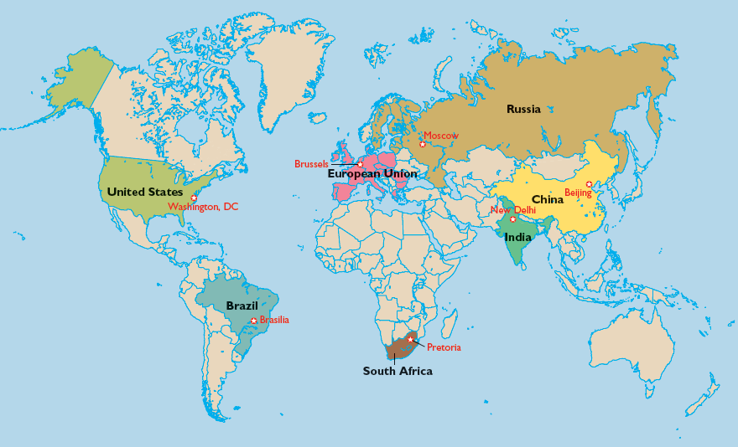
EXHIBIT 1.3 A MULTIPOLAR WORLD ECONOMIC ORDER

Slide 8
Key International Institutions That Facilitate Globalization
The International Monetary Fund (IMF)
The World Bank
The World Trade Organization (WTO)

Slide 9
The International Monetary Fund
International Monetary Fund’s role in global financial stability:
Provides a forum for cooperation on international monetary problems
Facilitates international trade that promotes job creation, economic growth, and poverty reduction
Promotes exchange rate stability and an open system of international payments
Lends countries foreign exchange to help address balance of payment problems

Slide 10
The World Bank
World Bank’s initial role was to aid the reconstruction of Europe after World War II.
Current focus areas:
Global integration through trade liberalization
Analysis and national trading policy advice
Agreements supporting international standards in financial systems
Information and knowledge transfer to developing countries to support sustainable development
Eradicating communicable diseases

Slide 11
The World Trade Organization
The WTO began trading in 1948 under the General Agreement on Tariffs and Trade (GATT).
Liberalized trade by lowering and/or removing trade barriers such as tariffs, quotas, and subsidies
WTO promotes global trade by:
Administering trade agreements
Acting as a forum for trade negotiations
Settling trade disputes
Reviewing national trade policies
Providing developing countries with technical assistance and training programs
Cooperating with the IMF and the World Bank

Slide 12
Multilateral Trading System Principles Fostered by WTO Agreements
Trade without discrimination
Increasingly freer trade
WTO Agreements
Predictability of trading relationships
Promotion of fair competition
Encouragement of economic reforms in developing countries

Slide 13
Institutional Structure and Its Impact on Globalization
What is institutional structure?
Institutions are the rules, enforcement mechanisms, and organizations that support market transactions.
Impact of globalization:
Demand for transparency, openness, and disclosure from political institutions
Need for adaptive institutions that provide societal stability and incentives for private investment
Increasing expectations of accountability and responsibility for those who govern
Importance of independent judiciary and free press

Slide 14
Effective Policy Measures That Promote Globalization
Good governance
Effective Policy Measures
Competitive markets
Property rights
Anticorruption policies

Slide 15
Impact of Information Technology on Globalization
The Digital Generation
Expanding the Global Use of Information Technology
The Digital Divide Myth
“Leapfrogging” into the Internet and Cell Phone Era

Slide 16
The Globalization Controversy
Arguments against globalization:
Job losses and income stagnation
Loss of local control over economic policies and developments
Disappearance of old industries
Related erosion of communities

Slide 17
Key Terms
globalization
emerging economies
decoupling
multipolar world
international monetary system
economic reforms
capital markets
liberalization of the trading system
institutions
adaptive institutions
accountability
transparency
antitrust laws
digital era
bandwidth
the web
digital divide
sustainable development

